Slide 1
Investigating the 3rd Party Android Apps
Part 1: Kik
Notes:
https://digitalcorpora.s3.amazonaws.com/corpora/mobile/android_10/Non-Cellebrite%20Extraction/Pixel%203.zip

Slide 2
Background

Slide 3

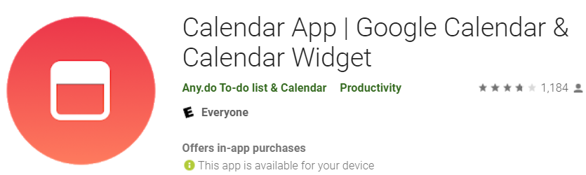
What is 3rd Party Android Apps?
A third-party app is a software application made by someone other than the manufacturer of a mobile device or its operating system.
e.g., app development companies or individual developers create a lot of applications for Apple’s or Google’s operating systems.
Example
com.appgenix.bizcal
com.simplemobiletools.calendar
Notes:
https://android.googlesource.com/platform/packages/apps/
https://android-developers.googleblog.com/2019/03/aosp-application-updates.html

Slide 4
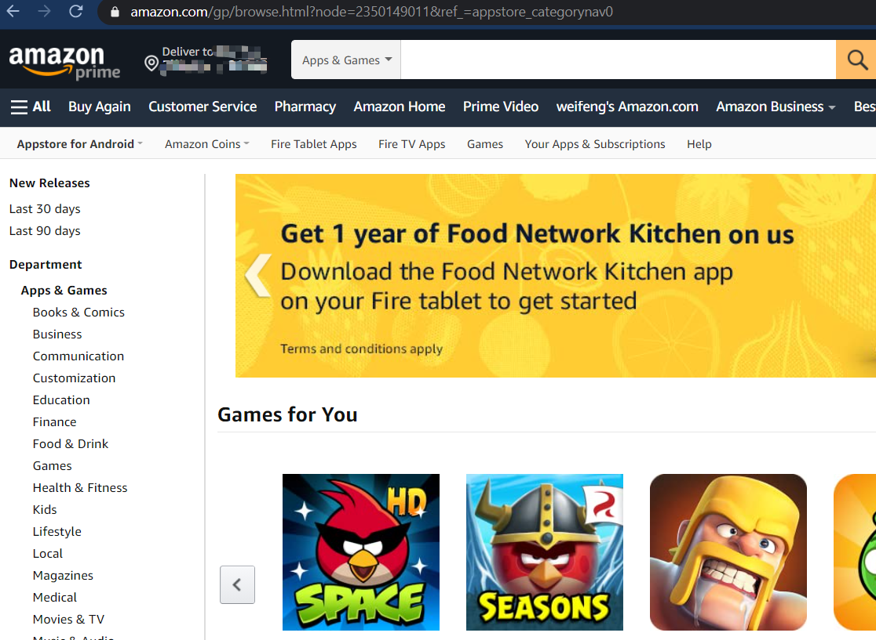

3rd Party App Store for Android
Amazon Appstore
APKMirror
APKPure
APKUpdater
Aptoide
F-Droid
Humble Bundle
QooApp
Samsung Galaxy Apps
Yalp Store

Slide 5
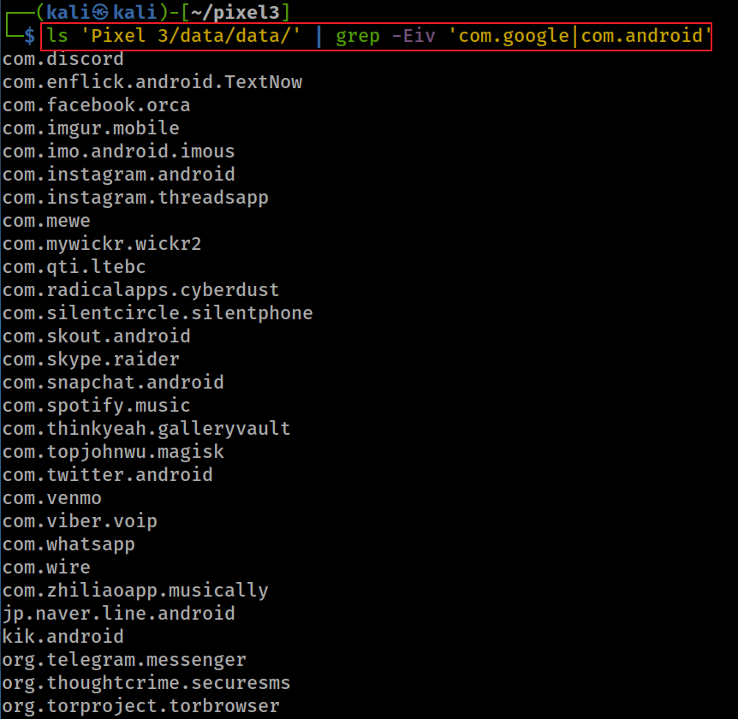
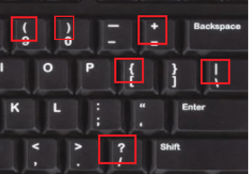
Show all 3rd apps ( apps except AOSP and Google apps)
-E: extended regular expressions
-v, --invert-match select non-matching lines
| : or
In basic regular expressions these characters lose their special meaning; instead use the backslashed versions ‘\?’, ‘\+’, ‘\{’, ‘\|’, ‘\(’, and ‘\)’.
Notes:
ls 'Pixel 3/data/data/' | grep -Eiv 'com.google|com.android’
com.discord
com.enflick.android.TextNow
com.facebook.orca
com.imgur.mobile
com.imo.android.imous
com.instagram.android
com.instagram.threadsapp
com.mewe
com.mywickr.wickr2
com.qti.ltebc
com.radicalapps.cyberdust
com.silentcircle.silentphone
com.skout.android
com.skype.raider
com.snapchat.android
com.spotify.music
com.thinkyeah.galleryvault
com.topjohnwu.magisk
com.twitter.android
com.venmo
com.viber.voip
com.whatsapp
com.wire
com.zhiliaoapp.musically
jp.naver.line.android
kik.android
org.telegram.messenger
org.thoughtcrime.securesms
org.torproject.torbrowser

Slide 6


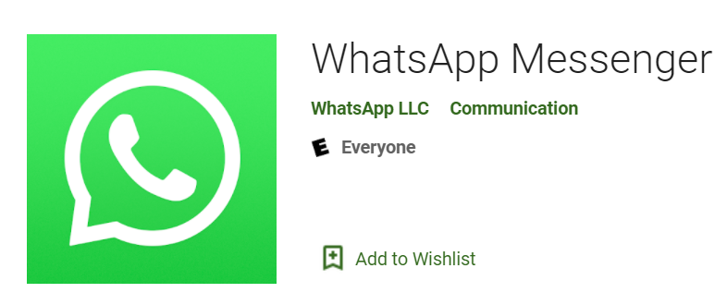
Goal: Analysis of three 3rd Party Apps
Investigating Kik app
com.kik.android
Investigating TextNow app
com.enflick.android.textnow
Investigating whatsapp app
com.whatsapp

Slide 7
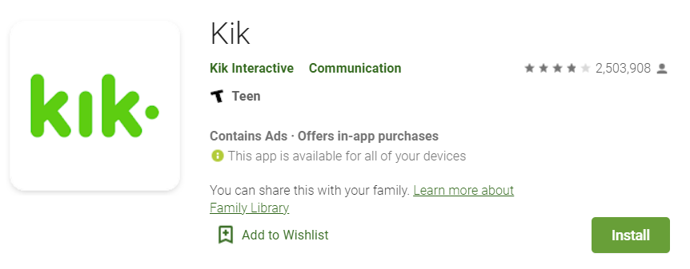
Investigating Kik app

Slide 8
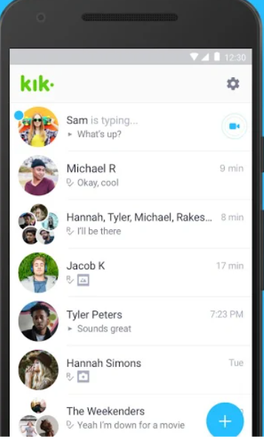
What is Kik app?
Kik is an instant messaging app
One-on-one/in-groups chat
Share pics, videos, gifs, games, etc
Meet new friends with similar interests
Main attraction
anonymity: no need for a phone number
Evidence types
Username
Messages
Last login time
Email associated with app
Install date
Version
Used by teenagers and young adults

Slide 9
Sample Questions
When was the app installed?
What is the version of the app?
What is Kik username?
What email is associated with the Kik account?
When did the suspect last log in to the app?
What are saved conversations?

Slide 10
shared_prefs of kik

Slide 11
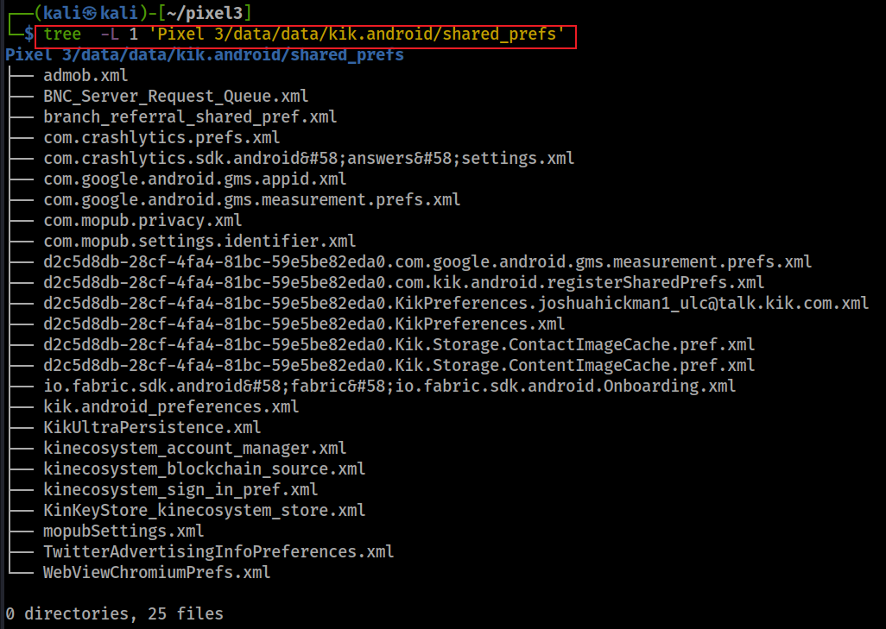
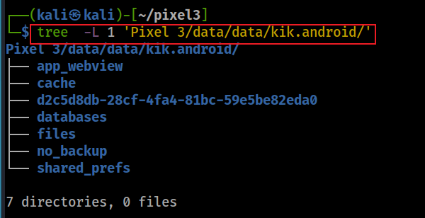
Preference files

Slide 12
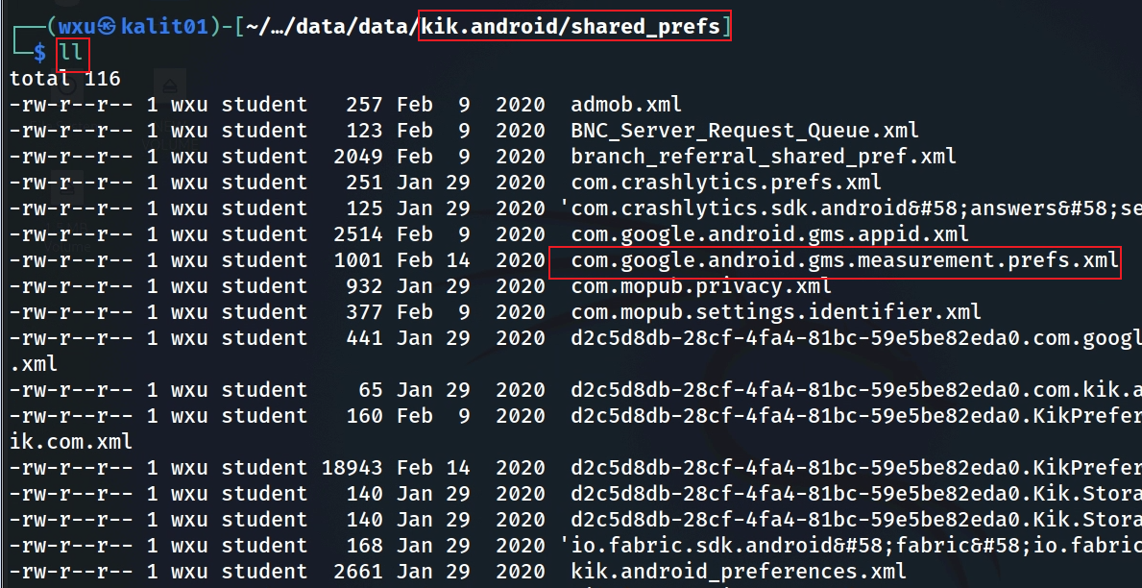
When was the app installed?
timestamp is here, but what is this?
Notes:
Cmd: ls 'Pixel 3/data/data/kik.android' (directory)
Cmd: ls 'Pixel 3/data/data/kik.android/shared_prefs'

Slide 13
What is com.google.android.gms.measurement service?
The module is part of the Google Play Services library, specifically tied to Firebase Analytics (formerly Google Analytics for Mobile).
It handles data collection and reporting for app usage, events, and user behavior.
Purpose: It allows apps like Kik to track user interactions (e.g., app opens, button clicks, session duration) and send this data to Firebase Analytics for analysis.
It’s commonly used for understanding user engagement, debugging, and improving app features.

Slide 14
What is com.google.android.gms.measurement.prefs.xml?
Created by com.google.android.gms.measurement service
stores small amounts of primitive data (e.g., strings, integers, booleans) as key-value pairs in an XML format.
Purpose of the File: It stores configuration settings, state information, or temporary data needed by the measurement module to function within the Kik app.
timestamps (installation, first open, last activity), identifiers (app ID, instance ID), and usage flags.
Limitation: focuses on metadata rather than user-generated content, limiting its overall significance in a forensic investigation.

Slide 15
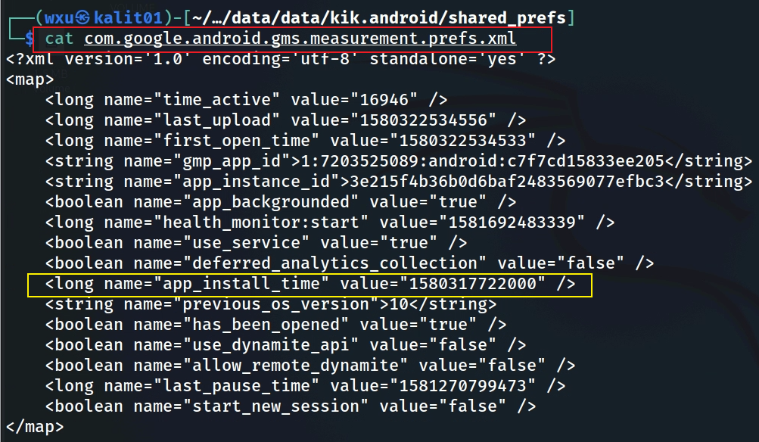
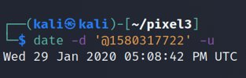
Search for installation timestamp
offering a timeline of app usage (e.g., installed on January 29, 2020, last active on February 9, 2020) and behavioral insights (e.g., minimal usage, analytics enabled).
Notes:
Cmd: cat 'Pixel 3/data/data/kik.android/shared_prefs/com.google.android.gms.measurement.prefs.xml'
Date cmd: date –d '@1580317722' -u

Slide 16
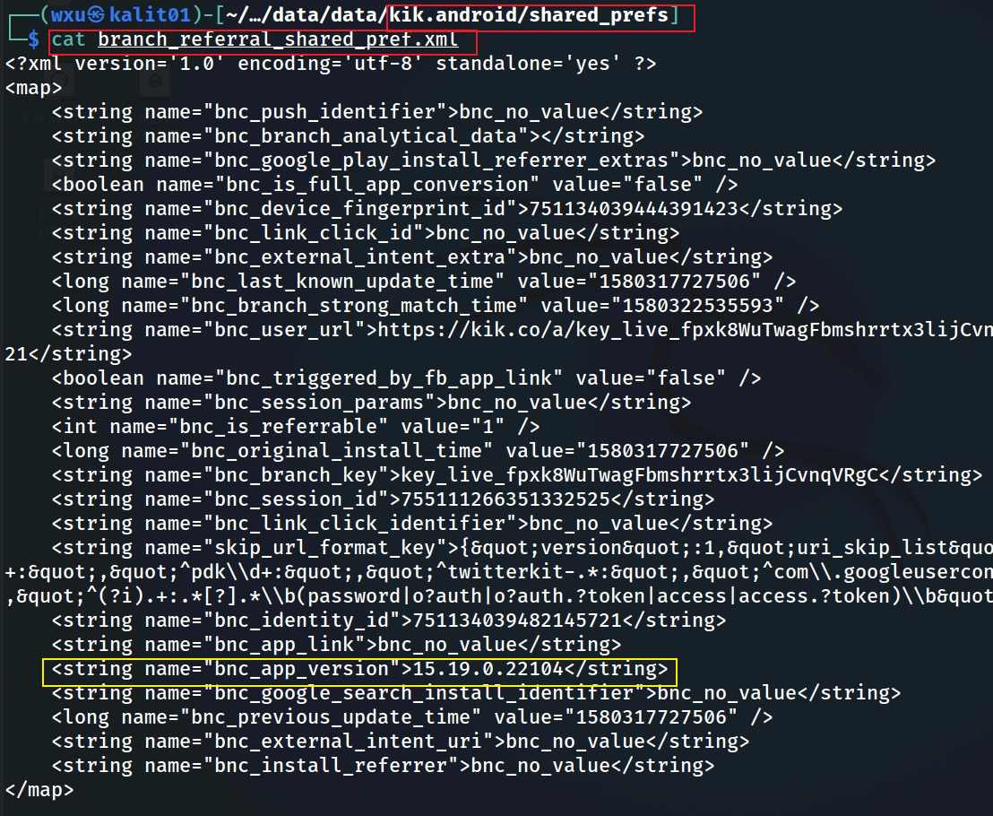
What is kik version?
bnc: Branch
Notes:
└─$ cat branch_referral_shared_pref.xml
<?xml version='1.0' encoding='utf-8' standalone='yes' ?>
<map>
<string name="bnc_push_identifier">bnc_no_value</string>
<string name="bnc_branch_analytical_data"></string>
<string name="bnc_google_play_install_referrer_extras">bnc_no_value</string>
<boolean name="bnc_is_full_app_conversion" value="false" />
<string name="bnc_device_fingerprint_id">751134039444391423</string>
<string name="bnc_link_click_id">bnc_no_value</string>
<string name="bnc_external_intent_extra">bnc_no_value</string>
<long name="bnc_last_known_update_time" value="1580317727506" />
<long name="bnc_branch_strong_match_time" value="1580322535593" />
<string name="bnc_user_url">https://kik.co/a/key_live_fpxk8WuTwagFbmshrrtx3lijCvnqVRgC?%24identity_id=751134039482145721</string>
<boolean name="bnc_triggered_by_fb_app_link" value="false" />
<string name="bnc_session_params">bnc_no_value</string>
<int name="bnc_is_referrable" value="1" />
<long name="bnc_original_install_time" value="1580317727506" />
<string name="bnc_branch_key">key_live_fpxk8WuTwagFbmshrrtx3lijCvnqVRgC</string>
<string name="bnc_session_id">755111266351332525</string>
<string name="bnc_link_click_identifier">bnc_no_value</string>
<string name="skip_url_format_key">{&quot;version&quot;:1,&quot;uri_skip_list&quot;:[&quot;^fb\\d+:&quot;,&quot;^li\\d+:&quot;,&quot;^pdk\\d+:&quot;,&quot;^twitterkit-.*:&quot;,&quot;^com\\.googleusercontent\\.apps\\.\\d+-.*:\\\/oauth&quot;,&quot;^(?i).+:.*[?].*\\b(password|o?auth|o?auth.?token|access|access.?token)\\b&quot;]}</string>
<string name="bnc_identity_id">751134039482145721</string>
<string name="bnc_app_link">bnc_no_value</string>
<string name="bnc_app_version">15.19.0.22104</string>
<string name="bnc_google_search_install_identifier">bnc_no_value</string>
<long name="bnc_previous_update_time" value="1580317727506" />
<string name="bnc_external_intent_uri">bnc_no_value</string>
<string name="bnc_install_referrer">bnc_no_value</string>
</map>

Slide 17
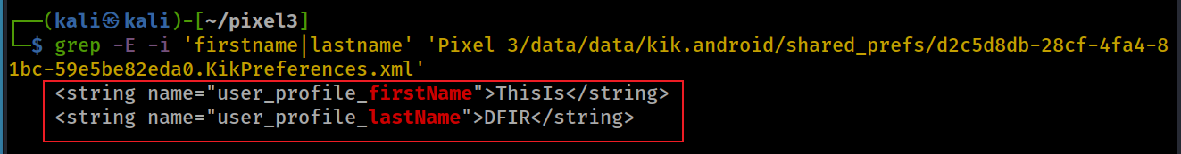
What registered name is associated with Kik account?
id for the user
Search for name keyword using grep

Slide 18
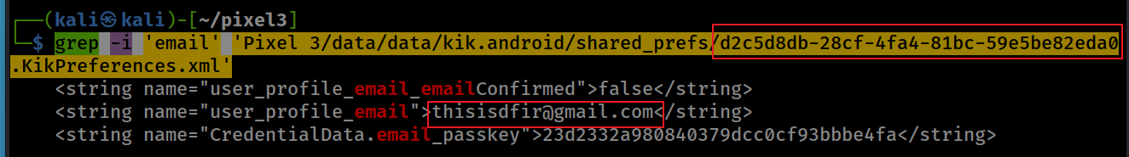
What email is associated with Kik account?
Search for email keyword using grep
Email: thisisdfir@gmail.com
Notes:
grep -i 'email' 'Pixel 3/data/data/kik.android/shared_prefs/d2c5d8db-28cf-4fa4-81bc-59e5be82eda0.KikPreferences.xml'

Slide 19
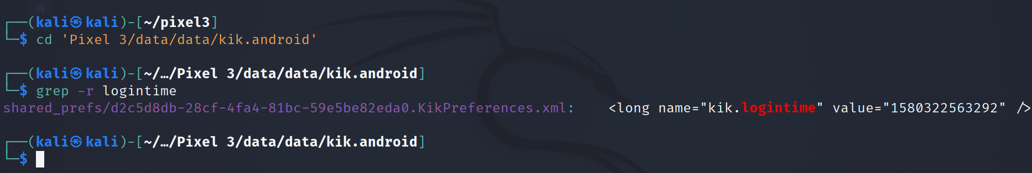
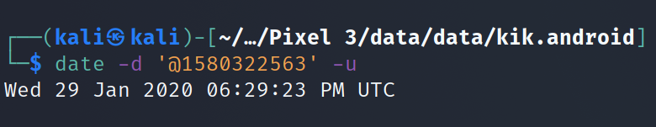
When did the user last log on?
Find the location of the package/folder
Search for keyword. Note we simply use grep to search all files in the directory
Notes:
Cmd: cd 'Pixel 3/data/data/kik.android'
Grep cmd: grep –r logintime
Date cmd: date –d '@1580322563' -u

Slide 20
databases of kik

Slide 21
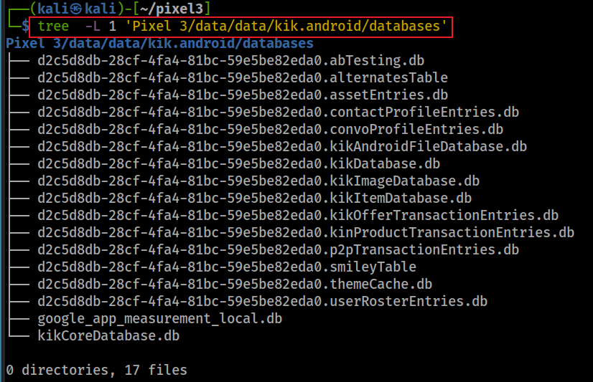
Package directory and databases
Notes:
tree -L 1 'Pixel 3/data/data/kik.android/’
tree -L 1 'Pixel 3/data/data/kik.android/databases'

Slide 22
kikCoreDatabase

Slide 23
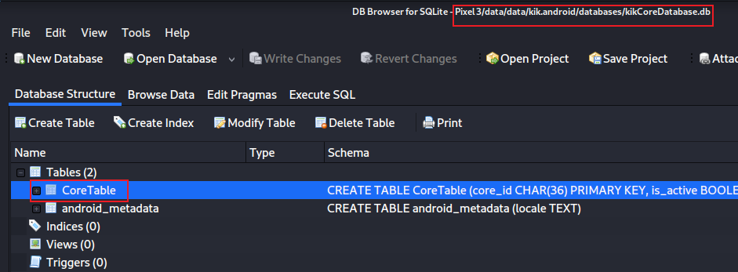
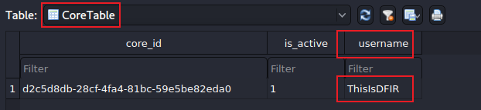
What is the Kik username ?
Open kikCoreDatabase
Exam CoreTable
id for the user
Notes:
sqlitebrowser 'Pixel 3/data/data/kik.android/databases/kikCoreDatabase.db'
cd 'Pixel 3/data/data/kik.android/’
grep –r username
d2c5d8db-28cf-4fa4-81bc-59e5be82eda0

Slide 24
KikDatabase.db

Slide 25
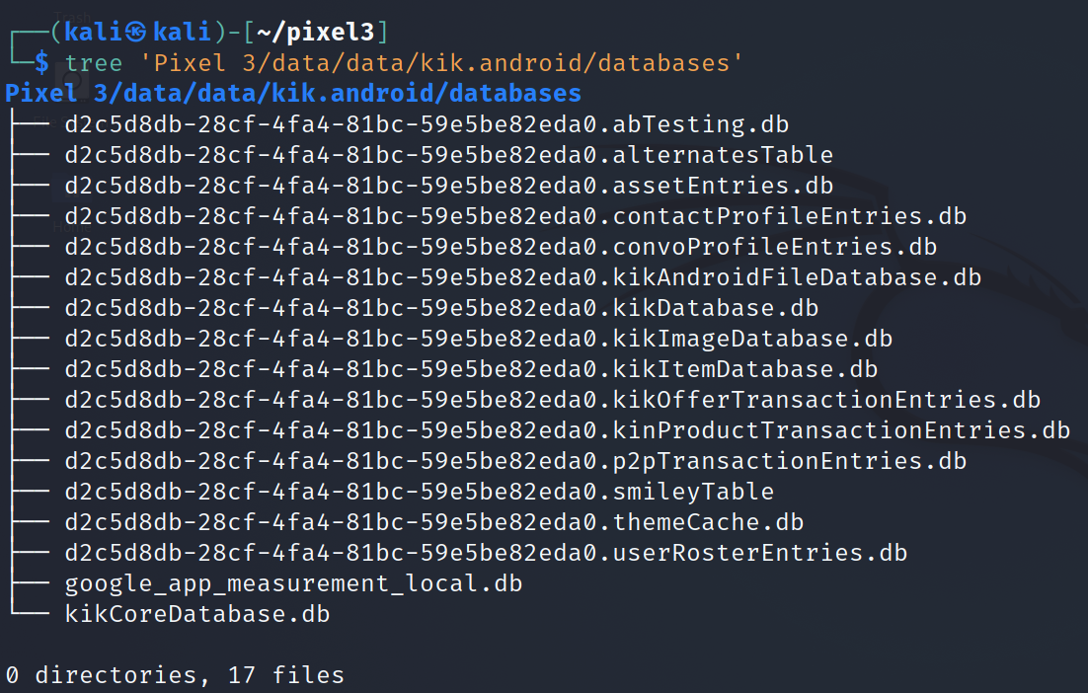
Look at the database list
Pay attention to the naming conversion:
coreID.otherdatabase.db
Notes:
Cmd: tree 'Pixel 3/data/data/kik.android/databases'

Slide 26
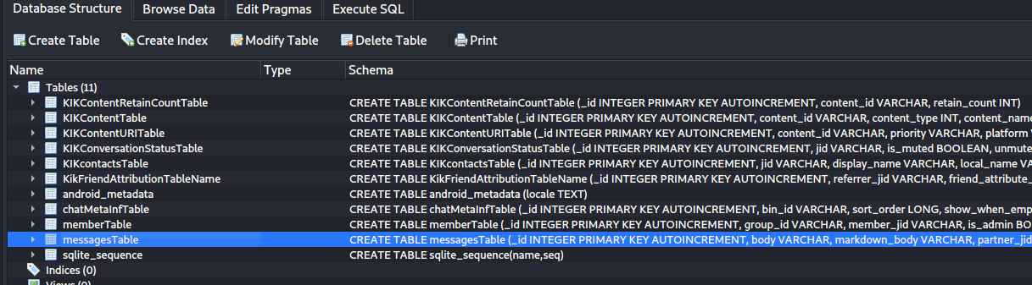
messageTable in KikDatabase.db

Slide 27
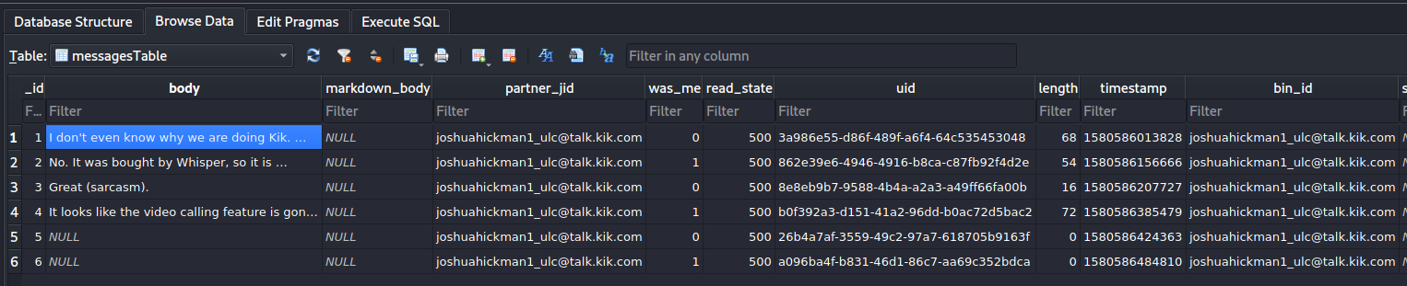
communicating partner jabber id
indicates it was sent or received message
0: received from others
1: owner
500: read
400: unread
200: unknown
300:sent undelivered
message content
what are these? (content other than text messages) =>next slide

Slide 28
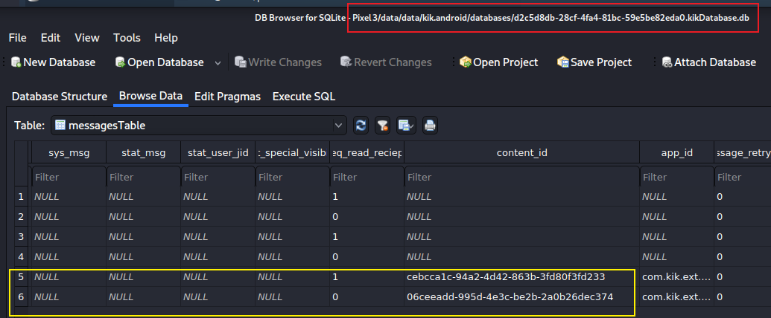
Find other types of messages based on content_id
Notes:
06ceeadd-995d-4e3c-be2b-2a0b26dec374.jpg
cebcca1c-94a2-4d42-863b-3fd80f3fd233.jpg

Slide 29
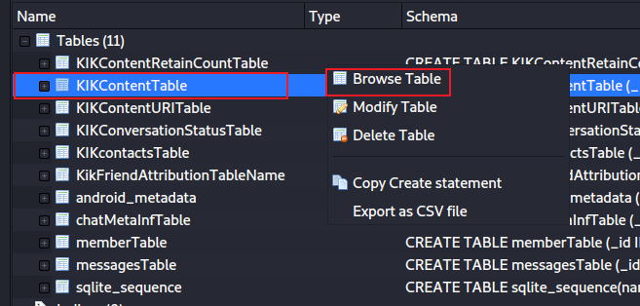
kikContentTable in KikDatabase.db
Find transferred file content based on content_id

Slide 30
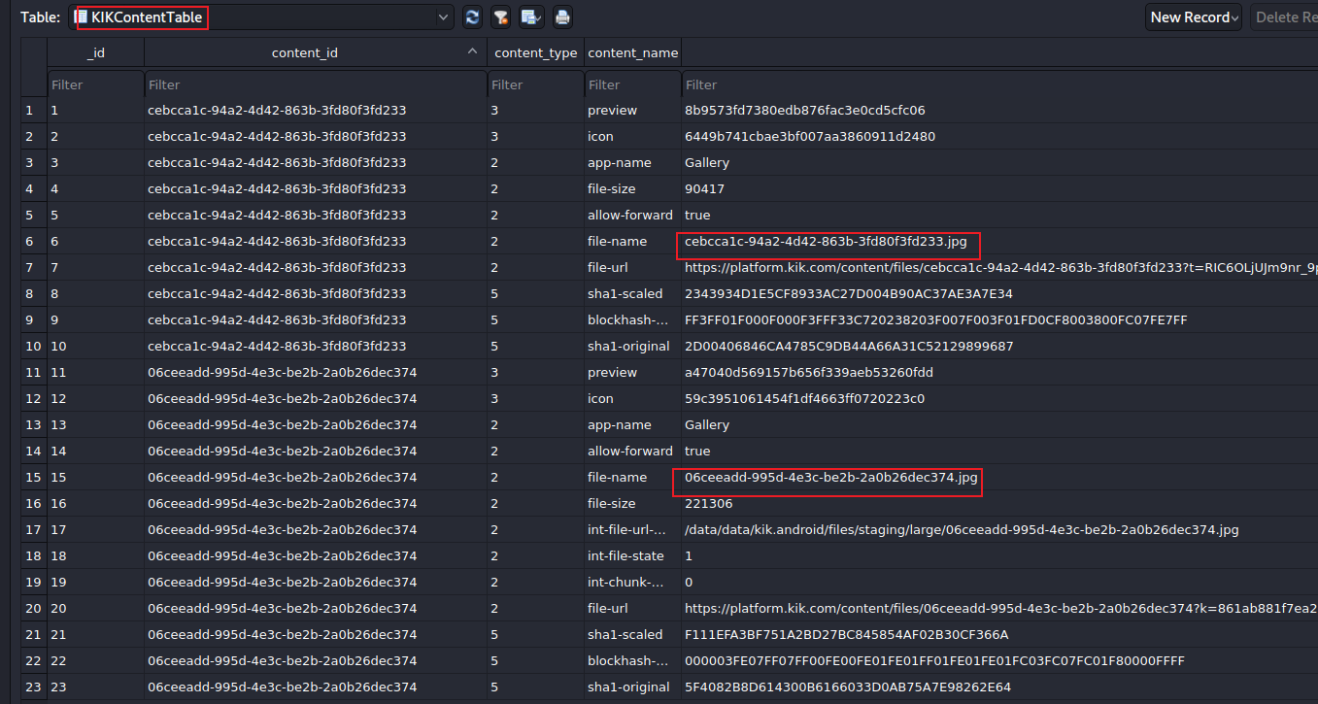
Find transferred jpg
can we retrieve images?
Notes:
/data/data/kik.android/files/staging/large/-I

Slide 31
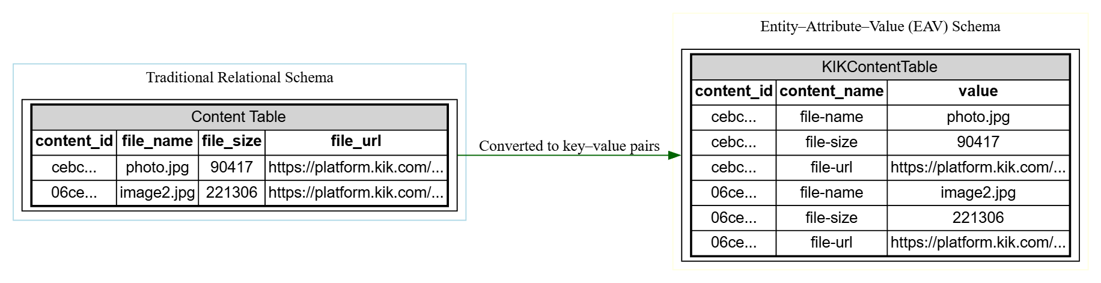








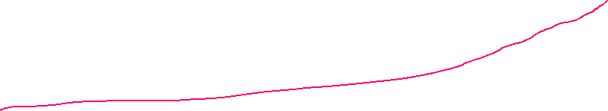
Database design pattern
Notes:
digraph EAV_Comparison {
rankdir=LR;
node [shape=box, style=filled, fillcolor=white, fontname="Helvetica"];
subgraph cluster_relational {
label="Traditional Relational Schema";
color=lightblue;
RelTable [label=<
<TABLE BORDER="1" CELLBORDER="1" CELLSPACING="0">
<TR><TD BGCOLOR="lightgray" COLSPAN="4">Content Table</TD></TR>
<TR><TD><B>content_id</B></TD><TD><B>file_name</B></TD><TD><B>file_size</B></TD><TD><B>file_url</B></TD></TR>
<TR><TD>cebc...</TD><TD>photo.jpg</TD><TD>90417</TD><TD>https://platform.kik.com/...</TD></TR>
<TR><TD>06ce...</TD><TD>image2.jpg</TD><TD>221306</TD><TD>https://platform.kik.com/...</TD></TR>
</TABLE>
>];
}
subgraph cluster_eav {
label="Entity–Attribute–Value (EAV) Schema";
color=lightyellow;
EAVTable [label=<
<TABLE BORDER="1" CELLBORDER="1" CELLSPACING="0">
<TR><TD BGCOLOR="lightgray" COLSPAN="3">KIKContentTable</TD></TR>
<TR><TD><B>content_id</B></TD><TD><B>content_name</B></TD><TD><B>value</B></TD></TR>
<TR><TD>cebc...</TD><TD>file-name</TD><TD>photo.jpg</TD></TR>
<TR><TD>cebc...</TD><TD>file-size</TD><TD>90417</TD></TR>
<TR><TD>cebc...</TD><TD>file-url</TD><TD>https://platform.kik.com/...</TD></TR>
<TR><TD>06ce...</TD><TD>file-name</TD><TD>image2.jpg</TD></TR>
<TR><TD>06ce...</TD><TD>file-size</TD><TD>221306</TD></TR>
<TR><TD>06ce...</TD><TD>file-url</TD><TD>https://platform.kik.com/...</TD></TR>
</TABLE>
>];
}
RelTable -> EAVTable [label="Converted to key–value pairs", color=darkgreen];
}

Slide 32
Can we retrieve images?
We checked the urls and local disk. Nothing were found.
Notes:
https://platform.kik.com/content/files/06ceeadd-995d-4e3c-be2b-2a0b26dec374?k=861ab881f7ea206f63d02586236b22b801af502b
https://platform.kik.com/content/files/cebcca1c-94a2-4d42-863b-3fd80f3fd233?t=RIC6OLjUJm9nr_9pRoRark_QO4Y1cR13CKjm8JRrP3ko0_0yywYhlAdzGYc4MEr6Ag183Hi_9JD69c1_lsCfzfNE51l0n-1O1c4g1n_sW2FSLVxodUGQ_jMSzc8vXjec

Slide 33
Entity–Attribute–Value (EAV) mode
The Entity–Attribute–Value model (often shortened to EAV) is a database design pattern
data is stored in a tall, narrow table instead of a wide one.
Column | Meaning
Entity (or ID) | Identifies the object the data describes
Attribute (or Key) | Names what property this row stores
Value | The actual value of that property
Many apps, such as Kik, Telegram, and some analytics or medical systems use it.

Slide 34
Example: Traditional vs. EAV schema
Traditional (fixed columns): efficient if all objects share the same attributes.
content_id | file_name | file_size | file_url
A1 | photo.jpg | 90417 | https://platform.kik.com/...
A2 | video.mp4 | 1204500 | https://platform.kik.com/...
EAV (Entity–Attribute–Value)
content_id | attribute | value
A1 | file_name | photo.jpg
A1 | file_size | 90417
A1 | file_url | https://platform.kik.com/...
A2 | file_name | video.mp4
A2 | file_size | 1204500
A2 | file_url | https://platform.kik.com/...

Slide 35
EAV Advantages and Disadvantages
Advantage | Explanation
Flexible schema | Add new attributes without altering table definitions
Space-efficient | Avoids wide tables full of NULLs
Generic processing | The same code can store arbitrary metadata
Disadvantage | Explanation
Complex queries | To reconstruct objects, you must join or pivot multiple rows
Poor performance on large datasets | Requires more joins and aggregations
Weaker data typing | “Value” column may mix text, numbers, etc.
Harder to enforce constraints | No column-specific foreign keys or NOT NULL constraints

Slide 36
Real-world analogy
Normal (wide)
Person | Age | City | Phone
Alice | 25 | Paris | 555-1111
Bob | 40 | London | 555-2222
EAV (tall)
Person | Attribute | Value
Alice | Age | 25
Alice | City | Paris
Alice | Phone | 555-1111
Bob | Age | 40
Bob | City | London
Bob | Phone | 555-2222

Slide 37
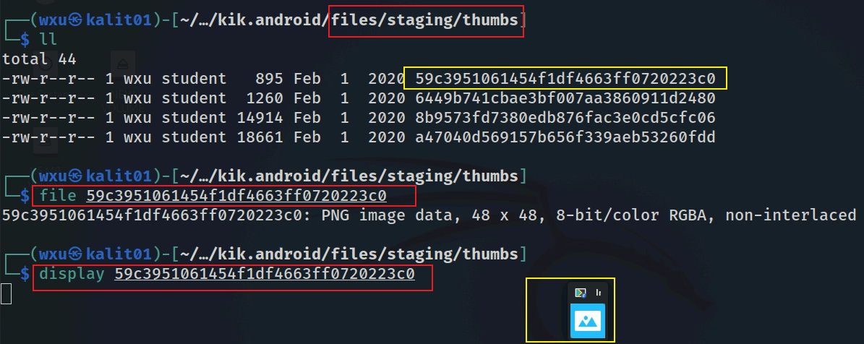
We retrieve thumb of the picture

Slide 38
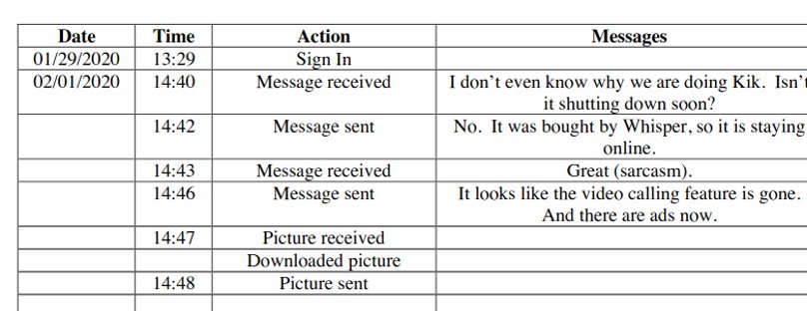
Results of messages

Slide 39
To summarize
Understand the application
Locate the app directory
Search the keywords username, logintime, email, version to get that info
Go to the databases directory
KikCoreDatabase.db has a unique ID for each user
other databases are generated based on ID
Go to shared prefs folder to find the install date of the app

Slide 40
Notes: Using ADB to access files (bash)
adb shell
run-as kik.android
chmod 777 shared_prefs/com.google.android.gms.measurement.prefs.xml
cp /data/data/kik.android/shared_prefs/com.google.android.gms.measurement.prefs.xml /sdcard
exit
adb pull /sdcard/com.google.android.gms.measurement.prefs.xml
Only works for Non-Rooted Devices with Debuggable App

